Slide 1

Topic 3: Academic integrity, Literature Review, and Citation and referencing.
Dr Fadi Safieddine
Dr. Fadi Safieddine copyright 2025
1

Slide 2
Lecture content
What is literature review?
What are the sections we would expect in a literature review?
Standards of academic writing.
Definition of Plagiarism in academic context.
What is Self-Plagiarism?
What is a reference or Citation?
Why do you need to reference?
Examples of citations
How to create Bibliography / reference list.
How to paraphrase or summaries.
How to find citations and references online.
2

Slide 3
Literature Review:
Most projects / reports in university follows the following structure:
Title Page
Contents page
Chapter 1: Introduction
Chapter 2: Literature review
Chapter 3: Methodology
Chapter 4: Results
Chapter 5: Discussion
Chapter 6: Conclusion
References
Appendices
Any idea what this is about?

Slide 4

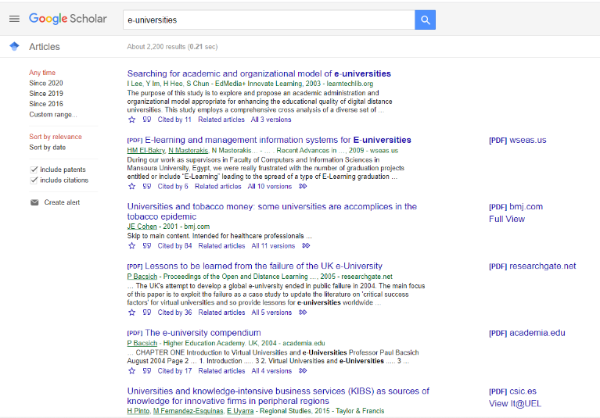
Literature Review:
A literature review surveys:
- Books, scholarly articles, and any other academic sources.
- Focuses area of research, or theory.
- Provides a description, summary, and critical evaluation of these works in relation to the research problem being investigated.

Slide 5
Literature Review:
The literature review may also include:
Give a new interpretation of old material,
Combine new with old interpretations,
Including major debates,
Evaluate the sources and advise the reader on the most pertinent or relevant research.
Usually in the conclusion of a literature review, identify where gaps exist in how a problem has been researched to date.

Slide 6
Literature Review:
Typical Structure of a Literature Review:
Chapter 2: Literature Review
2.1. Introduction:
…
….
2.2. E-Universities::<<Key Terms and definition from the literature>>
…
2.2.1. Compare models:
…
2.3. Challenges and limitations:
…..
…………………
2.9. Gaps in the Literature:
……

Slide 7
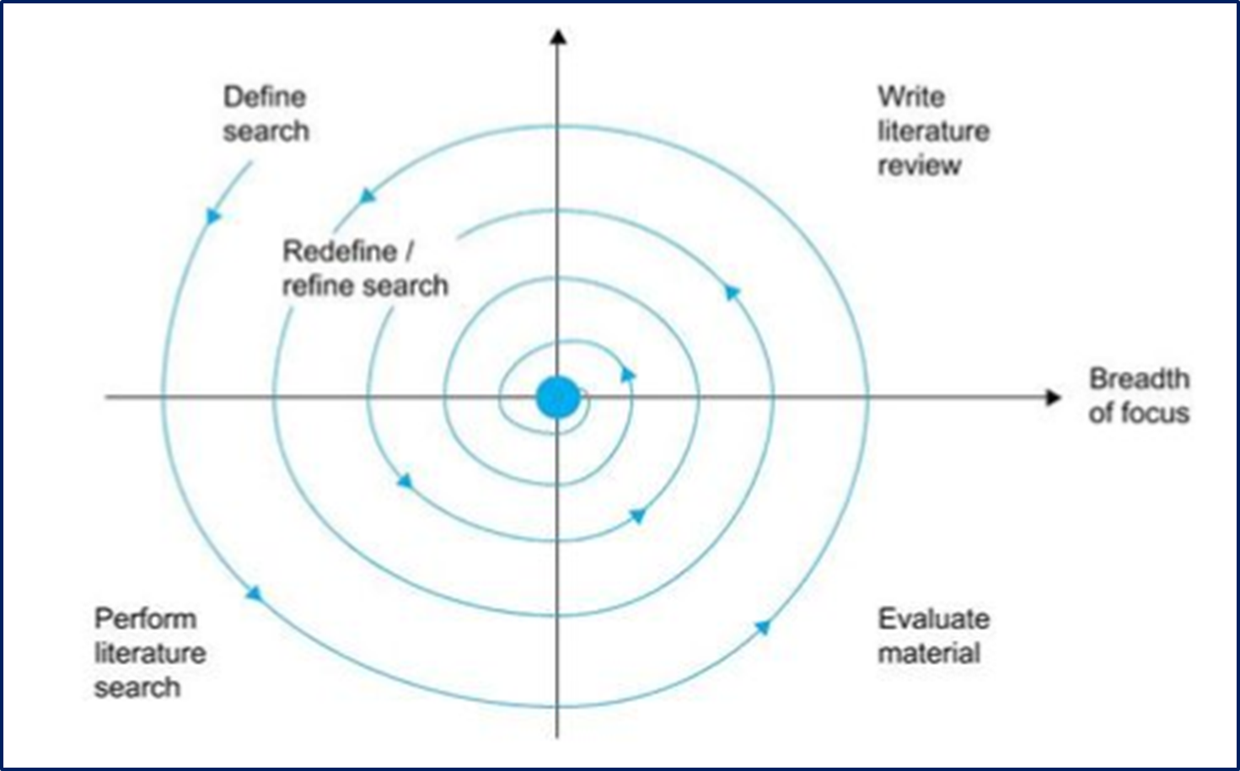
Steps to get started on your literature review:
Decide on a topic (“your personal itch!”)
Search for books /articles / projects.
Read and evaluate.
Note information down.
Choose topic headings.
Sort your information into the headings
Write up the literature review
Revisit and review again (it’s a cyclical process!)

Slide 8
Steps to get started on your literature review:

Slide 9
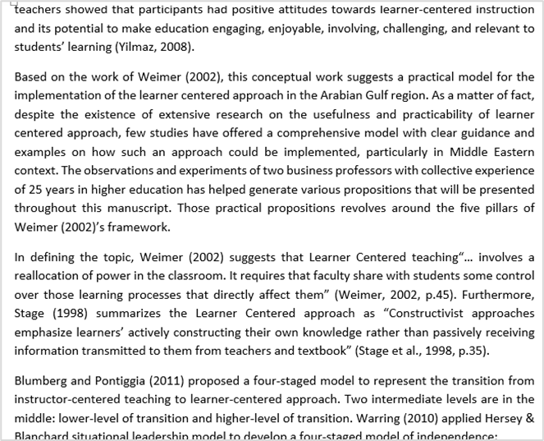
Literature Review:
Correct way of writing your literature:
……
Example of Literature review (Safieddine, 2021, p. 52)

Slide 10
Literature Review:
Correct way of writing your literature:
……
Example of Literature review (Safieddine, 2021, p. 52)

Slide 11
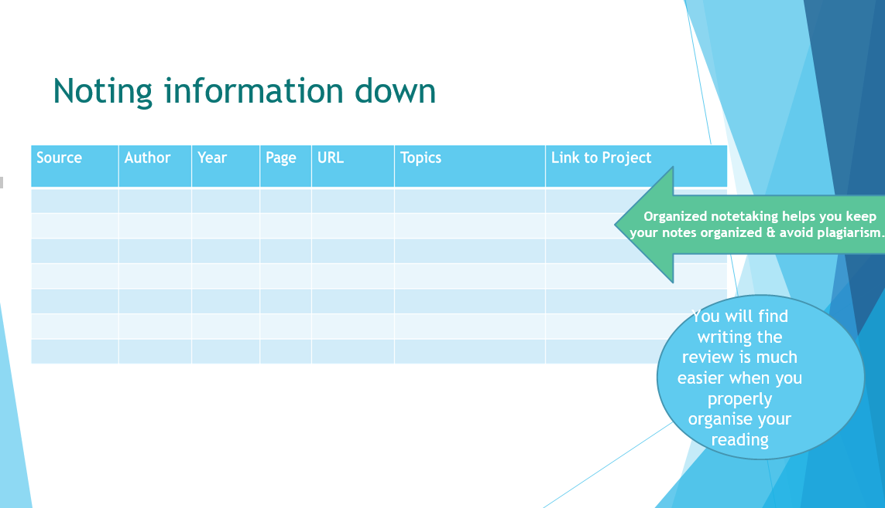

Slide 12
Literature Review:
Key notes to take from this:
Literature review is the biggest chapter in your documentation.
It is the work of other people related to your topic and project.
It is NOT your opinion or your work!!
Every paragraph has to have a citation of some sort and later the full reference (we will talk about it next).
You should end your literature review with a short reflection on things you found missing or not well researched in the literature.

Slide 13
Break 1:
How much time do you think you would need to put aside for your literature review?
Research
Reading
Writing
Citing
Editing

Slide 14
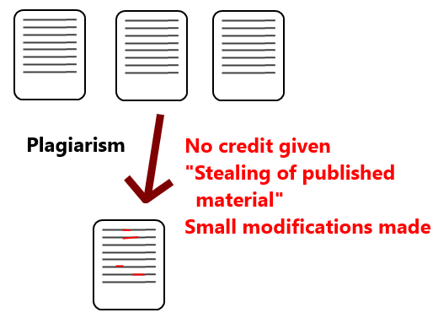
What is Plagiarism?
14

Slide 15
What is Plagiarism?
This is when you use other people’s ideas and words and you fail to acknowledge and reference them.
This is when you quote other people’s words but you fail to put quotation marks and indicate with a citation where the words are taken from.
When you do not do so, then you give the impression that you wrote those words and that is what we call plagiarism.
15

Slide 16

What is considered Plagiarism:
Copy and past text from online material.
Copy and past any text material not intended to be a “quote”.
Using photographs, video or audio without acknowledgement.
Using another people’s work and passing it on as “yours” even if you have permission- Cheating.
Using work you done before without proper citation.
16

Slide 17
What is considered Plagiarism:
17

Slide 18
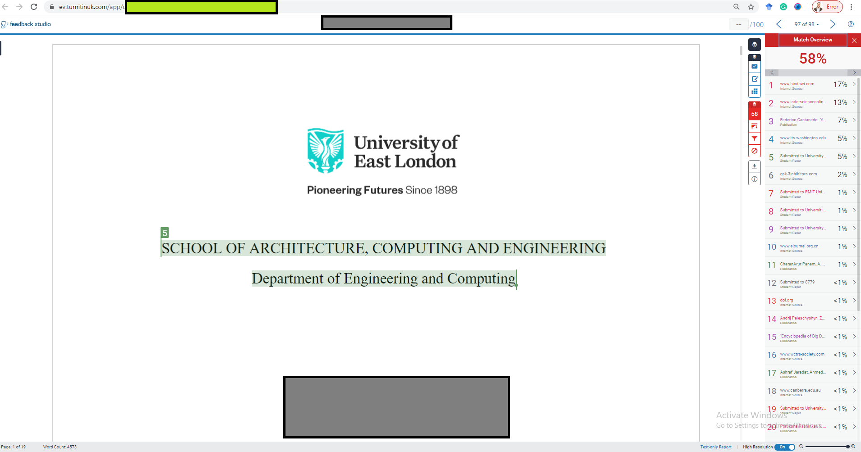
How Turnitin works:
18

Slide 19
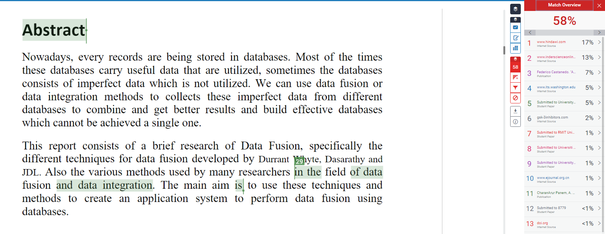
How Turnitin works:
Content when you write it in your own words
19

Slide 20
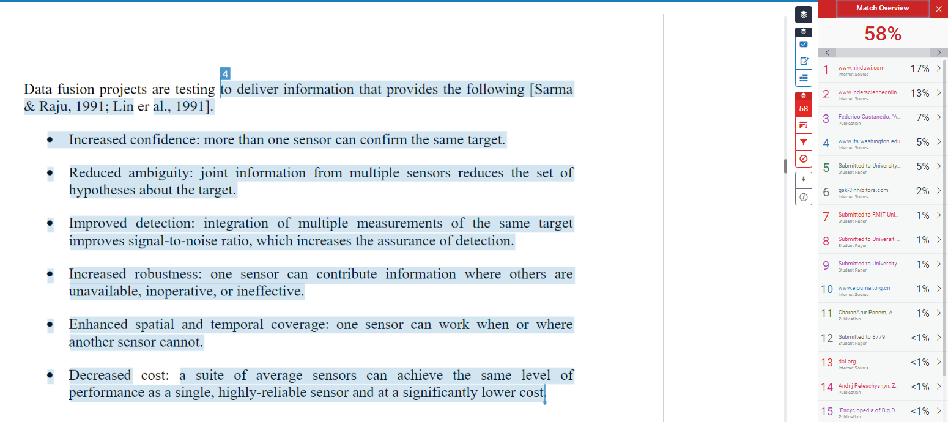
How Turnitin works:
Content from one source copied word for word.
Even though the student did put citation, it is wrong!
20

Slide 21
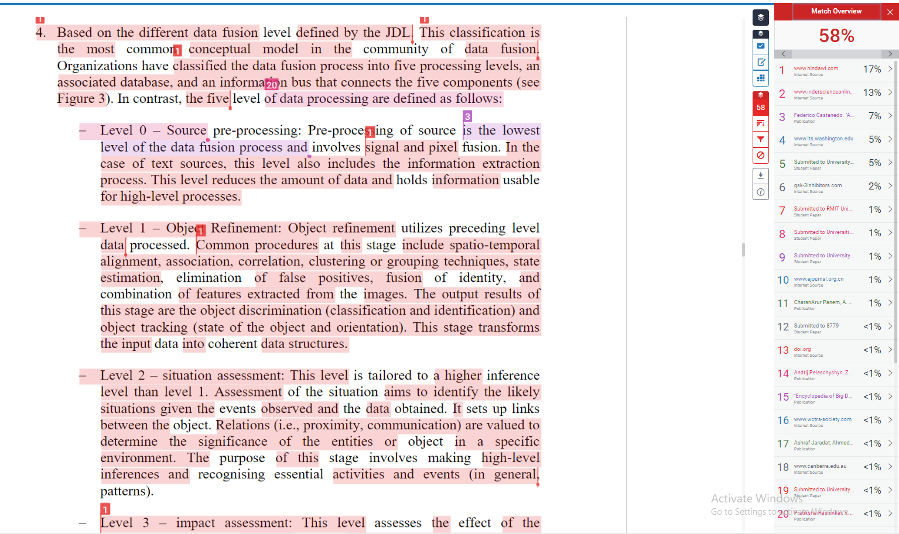
How Turnitin works:
Content when you copied but only few words changed.
21

Slide 22
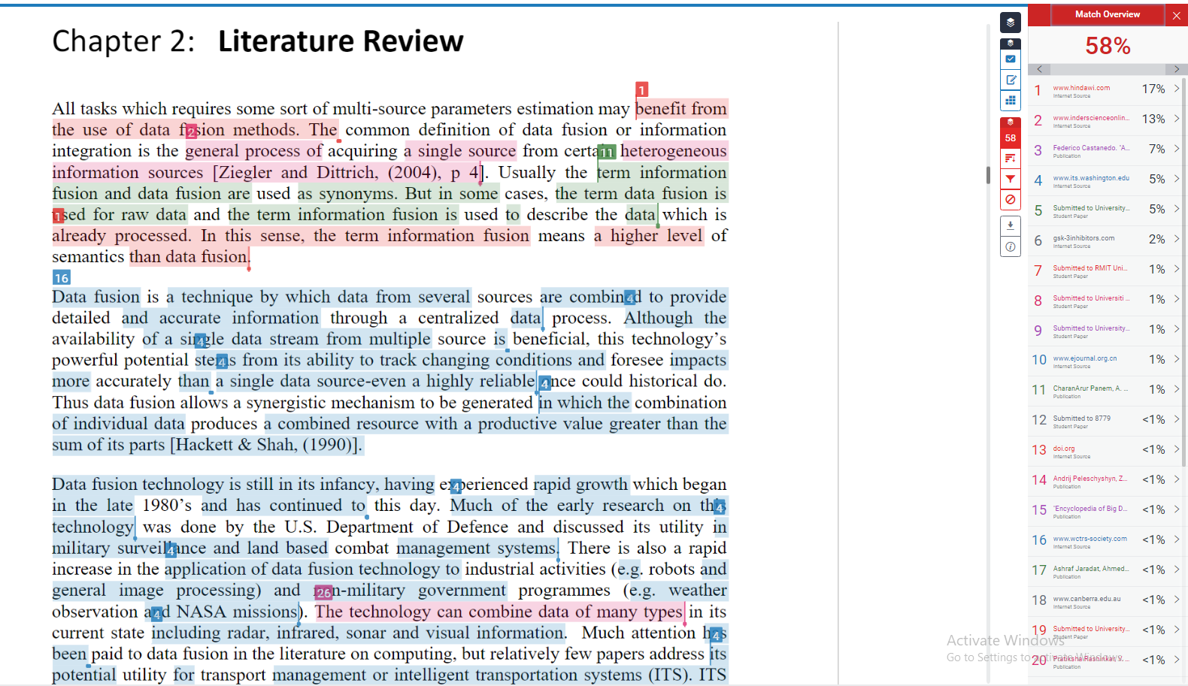
How Turnitin works:
Copying from multiple sources, thinking it would fool Turnitin.
22

Slide 23
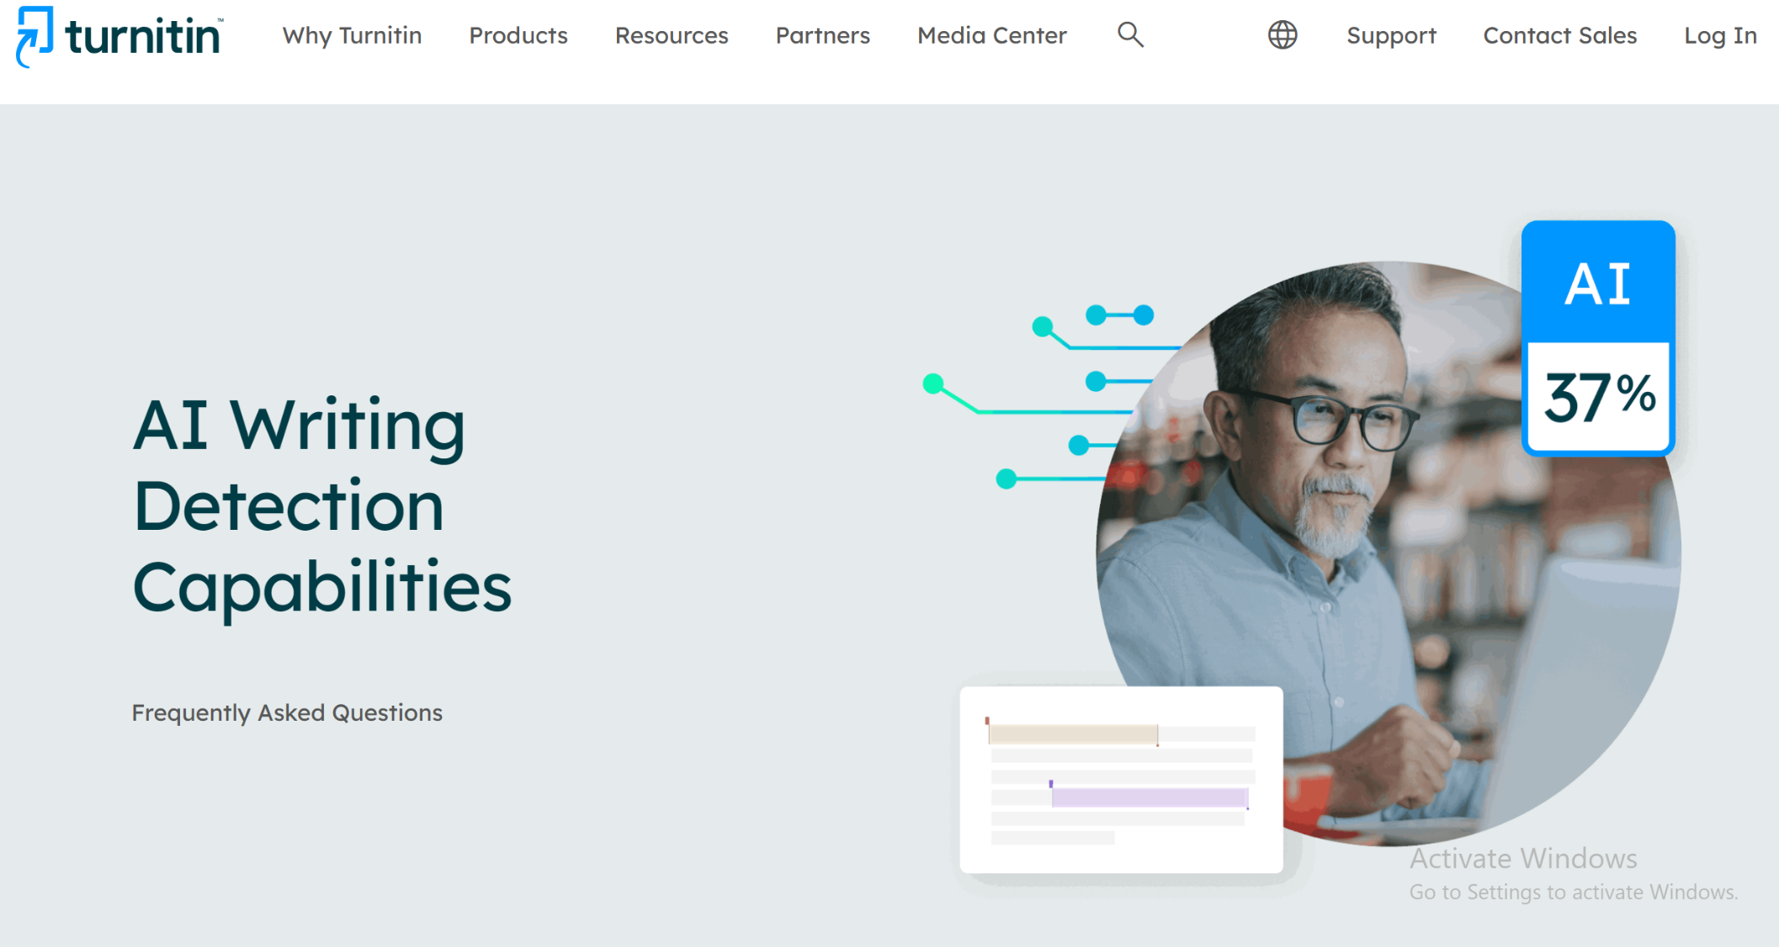
We have now tools to detect AI generated text

Slide 24
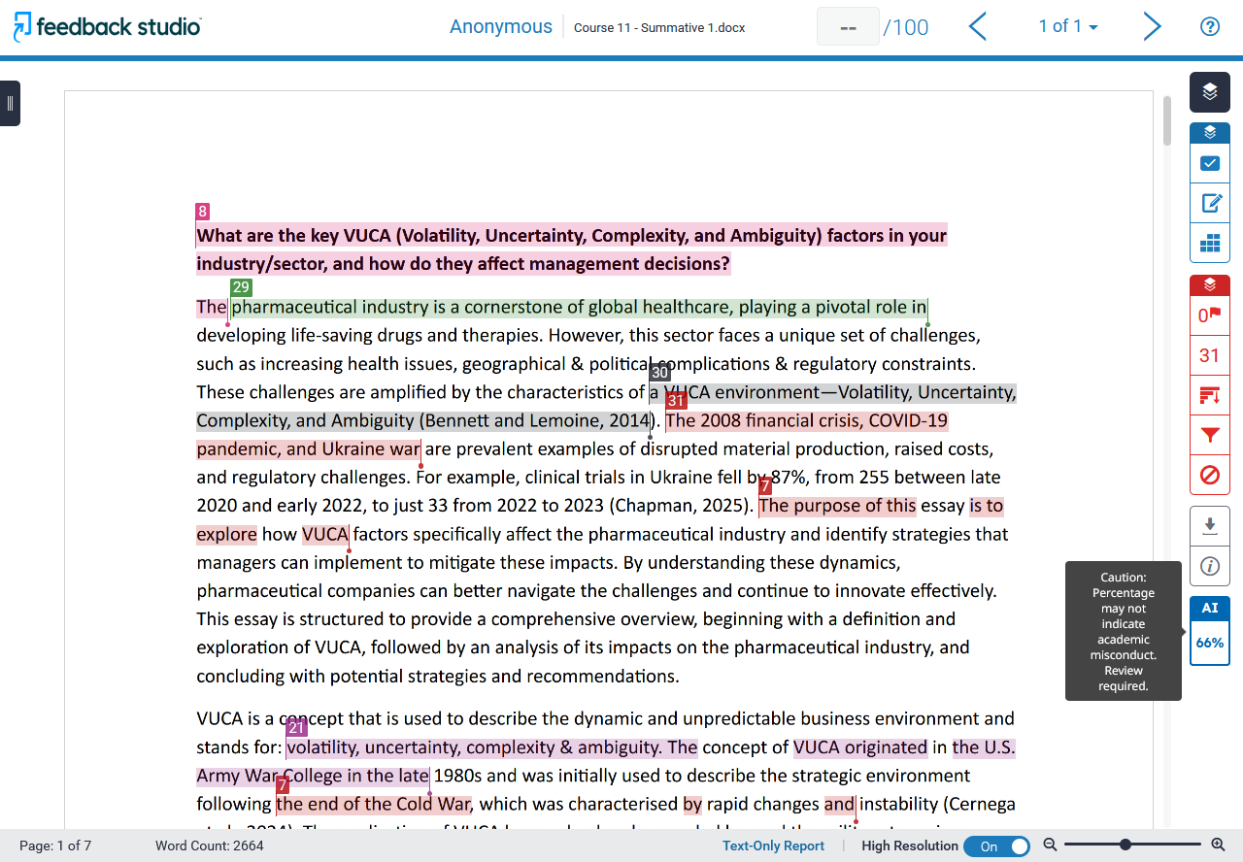
Turnitin will check your AI!

Slide 25
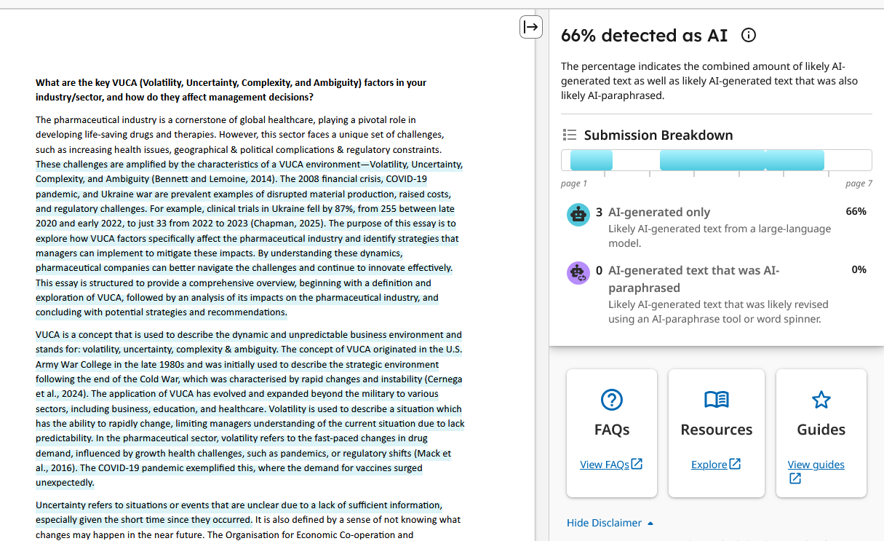
Turnitin will check your AI!

Slide 26
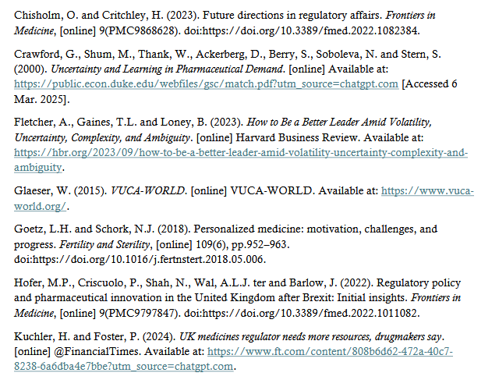
Turnitin will check your AI!

Slide 27
Turnitin will check your AI!

Slide 28
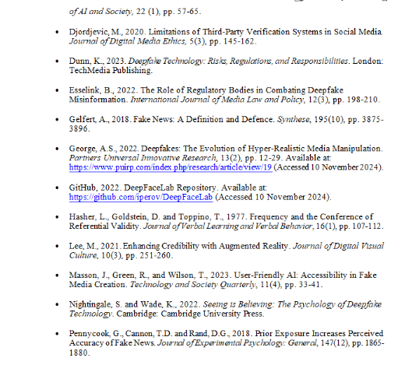
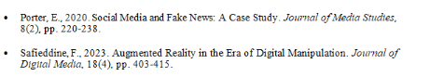
Fake references!!

Slide 29
Fake references!!

Slide 30

How to avoid Plagiarism?
Use your own words and cite the source of that information: paraphrase and summarise.
Mark your material as you find it, include in-text citation, and finally have an ‘End of document’ reference list.
You are permitted to use Quotation Marks when copying a author’s direct words – but do not over do it!
We will see examples of these later.
23

Slide 31
Break 2:
How can you see your Turnitin Report?

Slide 32
What is Citation/reference?
Citation/reference: Is the formal method of referencing a source of information in your work.
Types:
In text (Citation)
Footer (References)
End of Document (References)
UEL standard:
Harvard Style
25

Slide 33
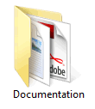
Types of Citation/reference?
In-text: Direct sources or quotes are references in the body of the assignment.
Single Author: You do so by including author’s family name, year and where applicable the page.
“M-commerce, a process of selling and buying using mobile devices, is and will continue to grow for the foreseeable future. The technology has its characteristics and limitations, but great opportunities for businesses as sales growth and new business models continue to outpace other technologies.” (Safieddine, 2017, p.227)
M-Commerce is a fast pace technology that continues to expand faster than any other technology (Safieddine, 2017).
Safieddine (2017) defines M-commerce as the process of selling and buying using portable devices such as mobile phones.
Safieddine, F., 2017. M-commerce. In Innovations in e-systems for Business and Commerce, Apple Academic Press. Florida, USA.
26

Slide 34
Types of Citation/reference?
27

Slide 35
Types of Citation/reference?
Chapter in a book:
Safieddine, F., 2017. M-commerce. In Innovations in e-systems for Business and Commerce, Apple Academic Press. Florida, USA.
28

Slide 36
Types of Citation/reference?
Author’s name: Family, First letter of first name.
Safieddine, F., 2017. M-commerce. In Innovations in e-systems for Business and Commerce, Apple Academic Press. Florida, USA.
29

Slide 37
Types of Citation/reference?
Year
Safieddine, F., 2017. M-commerce. In Innovations in e-systems for Business and Commerce, Apple Academic Press. Florida, USA.
30

Slide 38
Types of Citation/reference?
Title*
Safieddine, F., 2017. M-commerce. In Innovations in e-systems for Business and Commerce, Apple Academic Press. Florida, USA.
* Chapter, Article Title..…etc
31

Slide 39
Types of Citation/reference?
Book name
Safieddine, F., 2017. M-commerce. In Innovations in e-systems for Business and Commerce, Apple Academic Press. Florida, USA.
* The name of the book
32

Slide 40
Types of Citation/reference?
Safieddine, F., 2017. M-commerce. In Innovations in e-systems for Business and Commerce, Apple Academic Press. Florida, USA.
Publisher
33

Slide 41
Types of Citation/reference?
Safieddine, F., 2017. M-commerce. In Innovations in e-systems for Business and Commerce, Apple Academic Press. Florida, USA.
City and Country of publisher
34

Slide 42
Break 3:
Which one of these is a reference and which one is a citation of a source:
“Client scripts are interpreted by the client-browser and are tightly coupled with HTML/ASP inside the browser. ”(Negrino and Dori, 2001, p. 7).
Negrino, Tom and Smith, Dori (2001) JavaScripts: For the World Wide Web. 4th ed. Berkely: Peachpit Press.

Slide 43
Types of Citation/reference?
Two Authors: You do so by including each author’s family name, year, and page.
“Client scripts are interpreted by the client-browser and are tightly coupled with HTML/ASP inside the browser. ”(Negrino and Dori, 2001, p. 7).
Browsers interpret client side scripts based on the language they are associated with along with the HTML code (Negrino and Dori, 2001, p. 7).
Negrino and Dori (2001) explained the uniqueness of client scripts that embed themselves in the HTML code and are interpreted by the browser.
Negrino, T. and Smith, Do., 2001. JavaScripts: For the World Wide Web. 4th ed. Berkely: Peachpit Press.
36

Slide 44
Types of Citation/reference?
Three Authors: You do so by including each author’s family name and year.
“The setting up of e-university has been slow-going. Much of e-university slow progress has been attributed to poor business models, branding, disruptive technologies, lack of organisational structure that accommodates such challenges, and failure to integrate a blended approach.” (Ismail, Safieddine, Jaradat, 2019).
Many challenges face the re-introduction of e-universities (Ismail, Safieddine, Jaradat, 2019).
In defining e-university challenges Ismail, Safieddine, Jaradat (2019) explain that, among many things, the poor business model has hampered its reintroduction.
Ismail, R., Safieddine, F. and Jaradat, A., 2019. E-university delivery model: handling the evaluation process. Business Process Management Journal.
37

Slide 45
Types of Citation/reference?
Many Authors: More than three authors only include first author’s family name and follow it with et al, then year and page.
et al is Latin for ‘ and others’.
“E-learning has evolved over the last two decades from being a supplementary tool to becoming an essential companion to class teaching.” (Safieddine et al., 2016, P. 983).
It is hard to imagine a higher education institution that does not have a supplementary online e-learning tool (Safieddine et al., 2016, P. 983).
In a study on e-learning tools, Safieddine et al (2016) examined that tablets can be successful if restricted to educational purposes only.
Safiedine, F., Nakhoul, I., Kayapinar, U., Spathopoulou, F. and Kadry, S., 2016. System requirement analysis for e-learning educational tablets at higher education. In Proceedings in 10th International Technology, Education and Development Conference (pp. 983-989).
38

Slide 46
Types of Citation/reference?
More than one reference: If more than one author agree on a point, you can reference them with a “;”
Of course, you cannot use this for direct quote!
It is probably very difficult to include them as part of the sentence.
Several researchers have argued that websites start simple but quickly grow to become completely unmanageable and thus careful planning is an essential (Lang , 2001; Conallen, 2000; Safieddine, 2004; and Fraternali, 1999).
Of course all four papers and books should be referenced in your reference list.
39

Slide 47
Types of Citation/reference?
Direct quotes of less than 40 words:
Green module is a new terminology for teaching that goes beyond just paperless teaching: “A green module is a term the authors define a module that goes beyond paperless delivery to include collection of assessments, marking, and feedback in a completely paperless mood.”
(Safieddine, 2013, p. 1).
space
Safieddine, F. and Lee, S., 2013, ‘ 7th International Technology, Education and Development Conference’, Green modules for sustainability in higher education: A longitude study on impact on students. 4-5th March. Spain, Valencia.
40

Slide 48
Types of Citation/reference?
Direct quotes of more than 40 words:
Safieddine (2013) explains in his paper sustainability in higher education a new terminology:
A green module is a term the authors define a module that goes beyond paperless delivery to include collection of assessments, marking, and feedback in a completely paperless mood. This paper conducts an in depth reviews of four green modules with review of the implication of such a switch. This paper also considers what method educational institutes can use to implement a Green Module. (p. 1).
The results showed some surprises as not all modules switch had a positive response....
Safieddine, F. and Lee, S., 2013, ‘ 7th International Technology, Education and Development Conference’, Green modules for sustainability in higher education: A longitude study on impact on students. 4-5th March. Spain, Valencia.
41

Slide 49
Types of Citation/reference?
Direct quotes of more than 40 words:
Safieddine (2013) explains in his paper sustainability in higher education a new terminology:
A green module is a term the authors define a module that goes beyond paperless delivery to include collection of assessments, marking, and feedback in a completely paperless mood. This paper conducts an in depth reviews of four green modules with review of the implication of such a switch. This paper also considers what method educational institutes can use to implement a Green Module. (p. 1).
The results showed some surprises as not all modules switch had a positive response....
Safieddine, F. and Lee, S., 2013, ‘7th International Technology, Education and Development Conference, Green modules for sustainability in higher education: A longitude study on impact on students. 4-5th March. Spain, Valencia.
42

Slide 50
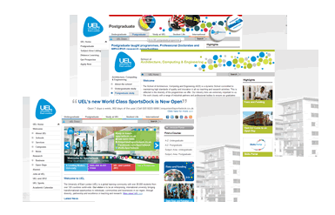
Type of Citation/reference?
Reference a website:
If you have an author:
Safieddine (2020) claims that on average every module that turns paperless green module saves a total of £2,400 a term.
If you have an organisation:
UEL Sport (Sportdock, 2020) lists at least ten sport activities on offer....
Safieddine, F., 2020, Profile. Available at: http://www.fadi.me.uk (Accessed 14 February 2020).
UEL Sportdock, 2020, Home Page. Available at: http://www.sportdock.co.uk (Accessed 14 February 2020).
43

Slide 51
Types of Citation/reference?
Reference a website:
Wikipedia:
Alan Turing is widely considered the father of computer science and artificial intelligence (‘Alan Turing’, 2013).
Photographs from the internet:
The design of his main photo (Safieddine, 2020) intended to model itself iphone/ipad logos.
‘Alan Turing’, 2020, Wikipedia. Available at http://en.wikipedia.org/wiki/Alan_Turing (Accessed: 14 February 2020)
Safieddine, F., 2020, Profile. Available at: http://www.fadi.me.uk (Accessed 14 February 2020).
44

Slide 52
Break 4:
Which one of these is correct or incorrect citations:
Many challenges face the re-introduction of e-universities. (Ismail, Safieddine, and Jaradat, 2019).
In defining e-university challenges (Ismail, Safieddine, and Jaradat 2019) explain that, among many things, the poor business model has hampered its reintroduction.
Many challenges face the re-introduction of e-universities (Ismail. R, Safieddine F., and Jaradat A., 2019).
In defining e-university challenges Ismail, Safieddine, and Jaradat, 2019 explain that, among many things, the poor business model has hampered its reintroduction.
Many challenges face the re-introduction of e-universities [1].
Many challenges face the re-introduction of e-universities (Ismail, Safieddine, and Jaradat, 2019).
In defining e-university challenges Ismail, Safieddine, and Jaradat (2019) explain that, among many things, the poor business model has hampered its reintroduction.
X
X
X
X
X
Y
Y
45

Slide 53
Types of Citation/reference?
46

Slide 54
What is Citation/reference?
Footer: Direct sources or quotes are referenced with a number that appear on the bottom of the page.
HTML or HyperText Markup Language is used to express the content and visual formatting of a Web page ¹.
You may see it by other referencing styles, but Footnotes are not used by Harvard Style.
You should NOT use footnotes in your assignment.
¹ Lemay, Laura., 2000, SAMS Teach Yourself Web Publishing with HTML 4. 2nd Edition. Indiana:Sams Publishing. Pages 51 – 52.
47

Slide 55
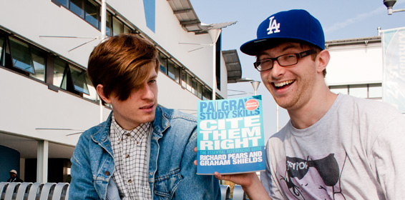
Types of Citation/reference?
There are many more possible sources that we cannot possibly cover all today:
Electronic books
Reprints editions
Translated books
Audiobooks
Sacred text : Bible, Torah, and Qur’an.
Journals
Newspapers
Conferences
Theses
Moodle / slides
CD / DVDs
Reports and Government publications
Radio/ Films
And many more!!
Get the book from library or Free: CITE IT RIGHT
Kortex
48
Notes:
Image source: http://www.uel.ac.uk/universe/issue003/bigbang.htm

Slide 56
References/Bibliography
At the end of your document – start a new page and call it ‘References’:
Center the word “References” without making it bold or italic at the top of the page.
Give the full information on how to access your sources:
in alphabetic order
a hanging indent
Double-space the whole page.
49

Slide 57
Example: References/Bibliography
References
Adams, W.J. and Jansen, J., 1997. Information technology and the classroom of the future. In Society for Information Technology & Teacher Education International Conference (pp. 484-488). Association for the Advancement of Computing in Education (AACE).
Ismail, R., Safieddine, F. and Kulakli, A., 2017, May. E-university lecture delivery model: From classroom to virtual. In 2017 International Conference on Engineering & MIS (ICEMIS) (pp. 1-7). IEEE......etc
Osmon, P., 2011. Paperless classrooms: a networked Tablet PC in front of every child. Proceedings of the British Society for Research into Learning Mathematics, 31(2), pp.55-60.
Safieddine, F., Ismail, R. and Kulakli, A., 2017. E-Universities: Reflective analysis into technological trends. In Procedia-15th International Conference e-Society 2017 (pp. 179-186).
Wang, J.F., 2010. Creating a Paperless Classroom with the Best of Two Worlds. Journal of Instructional Pedagogies, 2.
50

Slide 58
References/Bibliography
What is the difference?
Bibliography:
Cited material and material read but not cited are all included here.
Reference List:
Only cited material are listed in the reference list.
When to use both:
Reference list gives all items directly cited. Bibliography contains any other reading.
Both have same format but slightly different purpose.
51

Slide 59
Break 5
Assuming you collected all these references, organise them in alphabetic order, and correct formating:
Hammad, R, Khan, Z., Safieddine, F., and Ahmed, A. Oct 2020. A Review of Learning Theories and Models underpinning Technology-enhanced learning artefacts. World Journal of Science, Technology, and Sustainable Development – Emerald Publication.
Dordevic, M., Pourghomi, P. and Safieddine, F. Oct 2020. Identifying Fake News from the Variables that Governs the Spread of Fake News. SMAP 2020 - IEEE Workshop on Semantic and Social Media Adaptation and Personalization, Zakynthos, Greece.
Safieddine, F. and Hammad, R., Jul 2020. Fake News: Origins and Political Impact. In Handbook of Research on Recent Developments in Internet Activism and Political Participation (pp. 103-121). IGI Global Publishing.
Ibrahim, Y and Safieddine, F. (ed.) Feb 2020. Fake News in an Era of Social Media: Tracking Viral Contagion. Rowman & Littlefield.
Pourghomi, P., Dordevic, M. and Safieddine, F. Jan 2020. Facebook Fake Profile Identification: Technical and Ethical Considerations. International Journal of Pervasive Computing and Communications.
Ismail, R., Safieddine, F. and Jaradat, A. March 2019. E-university delivery model: handling the evaluation process. Business Process Management Journal. 25 (7), pp. 1633-1646.
Jaradat, A., Abu Halimeh, A., Deraman, A. and Safieddine, F. 2018. A best-effort integration framework for imperfect information spaces. International Journal of Intelligent Information and Database Systems. 11 (4), pp. 296 - 314.

Slide 60

Using your own words:
53

Slide 61
Using your own words:
It is important you do not copy/paste.
And when using ‘Quotes’ use it for important things only.
You need to demonstrate you understand what you read and you explain it correctly:
Two methods:
Paraphrasing
Summarising
54

Slide 62
Using your own words:
Paraphrasing:
Presenting an idea or argument in your own words.
Make sure it is significantly altered from its original text without changing the context to avoid plagiarism
Even though you are paraphrasing it is good practice to include the page number where you found that information.
HTML stands for HyperText Markup Language. HTML is used to present the content and visual format of a Web page (Lemay, 2000, p. 51).
55

Slide 63
Using your own words:
Summarising:
Just outlining the brief summary of the subject or information.
Summaries tend to refer to the whole work or to a large sections of it.
Summaries do not require page numbers.
Several researchers have argued that websites start simple but quickly grow to become completely unmanageable and thus careful planning is an essential (Lang , 2001; Conallen, 2000; Safieddine, 2004; and Fraternali, 1999).
56

Slide 64
Essential training and reading:
Several documents are found online to support these slides:
PDF file online on academic misconduct.
Google Scholar https://scholar.google.com/
Harvard Online Generator
https://www.harvardgenerator.com/
57

Slide 65
Demo of using quick tools

Slide 66
Break 6:
Paraphrase any part of the follow quote using your own words:
“Recently, Google and Facebook have made attempts to develop fact-checking tools that rely on third-party fact-checkers with limited success,” Dr Safieddine explains.
He added: “However, the ability to combat the spread of fake news remains limited and hampered by the slow response of third-party fact-checkers.
Source: https://www.uel.ac.uk/news/2020/02/fake-news-spreads-like-disease-according-to-uel-academic
Include citation of source and reference the end. Show it to tutor in the lab before submitting it.

Slide 67
Additional Support!!

Slide 68
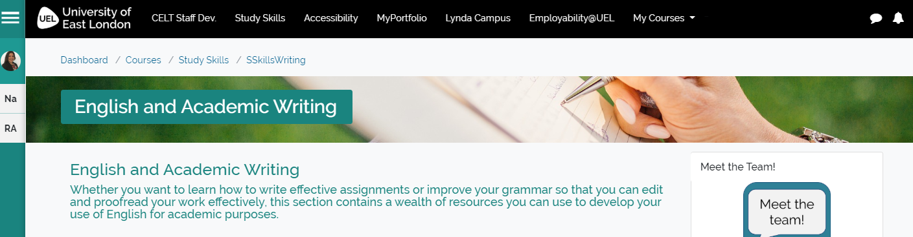
Academic Tutors - How we can help
Student Development Sessions (SDS)
Drop in sessions
Online resources

Slide 69
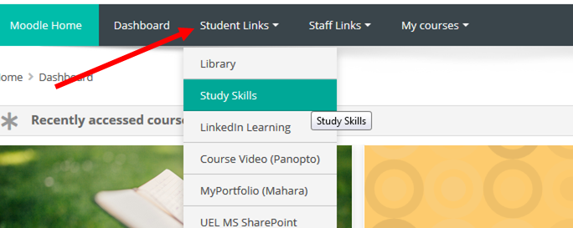
How to find us
Notes:
The latest information about our workshops and other events.
Tips, advice and information on study skills.
Hundreds of interactive resources, worksheets, quizzes, and other useful things to download.
Links to the best skills development websites.
Useful information about how to maximise your study time.
Details on how to contact us.

